Slide 1
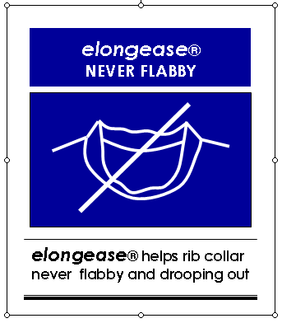
Introduction of the patent and the round P/U tape

Slide 2
Let’s think over this matter before going to the this subject…
What kinds of core values enable the brand business sustainable success ?
People say ;
BRAND IMAGE (Equity)
BRAND IMAGE: Customers’ feedback on BRAND
Feedback: Product Integrity such as product quality including durability, appearance etc. and E.S.G management such as CSR

Slide 3
Customers’ feedback on BRAND’s Product?
If a product become as shown on the photo
What’s consumers’ feedback on a Brand?
If a product causes a bad feedback on the Brand, it might be better not to supply this product to market

Slide 4
Contents
Introduction of the construction method patented distinctive
2 kinds of construction method to be applied
The information for how to source the round tape
Comparison with the appearances, the current and the patented
The several existing ways applied on the material of rib collar in order to reduce “Flabby rib collar”
The style to be applied with the new construction of “Not flabby rib collar”
The examples of consumers’ complaints about “Flabby rib collar”
Q & A

Slide 5
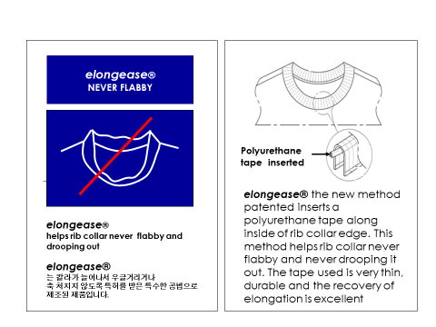
1. Introduction of the construction method patented what is distinctive
* The permanent round type TPU tape is inserted and settled along with the inside edge of rib collar, hence the rib collar is never flabby over the garment lifetime. r the garment lifetime을 실현할 수 있음

Slide 6
2. 2 kinds of construction method to be applied
1) Straight type TPU tape is applied
Sequence
Cut TPU tape as the same length of rib cut piece
2. Place TPU tape on the center of rib cut piece
Sew the baste stitch each ends to fix the tape on to rib
Join – sew rib edges (seam)

Slide 7
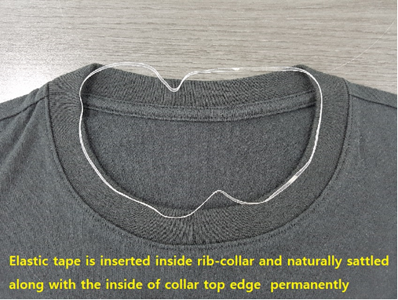

2. 2 kinds of construction method to be applied
2) Rounded type TPU tape applied
*** Rounded type is developed to insert tape easily for more conveniently applied
Just insert rounded tape into rib collar without baste stitching

Slide 8
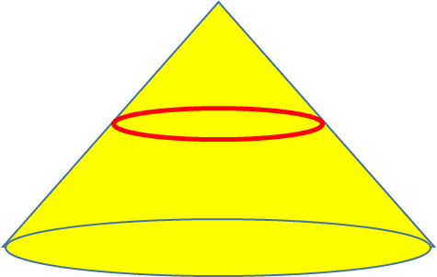

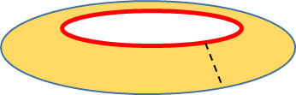
2. Why is TPU Tape always be in along with inside of the neck edge?
When the annular tape is placed on the cone, the tape is positioned at the same point on the circumference of the cone as the perimeter of the tape.
After sewing the ends of the rib collar cut, turn it inside out by inserting the round tape inside when turning it over.
When the rib collar is attached to the body, the circumference of the base increases as shown in the figure, so the annular tape is naturally always positioned inside the rib collar top edge.
V-Neck also uses the same principle as above, and if you just put a round TPU tape in the same size as the circumference of the V-neck edge, the tape will naturally take its place in the V-Neck shape and show the same effect

Slide 9
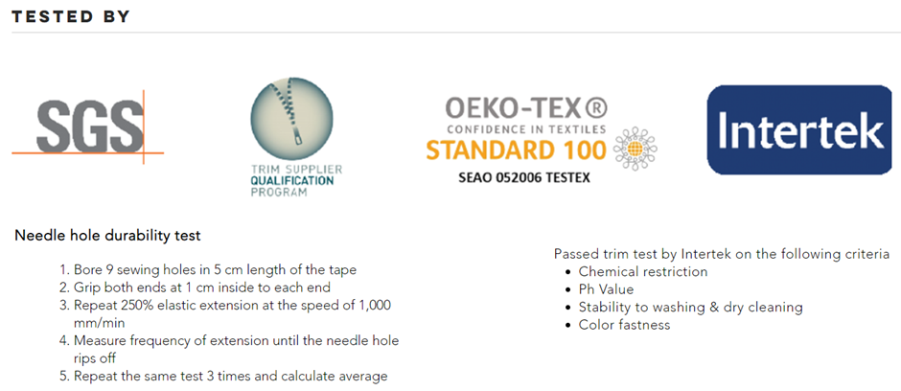
3. The information for how to source the round tape
*Material safety tested
T-225033
Length : 225mm / Width : 3mm / Thickness : 0.3mm
*** Lengths will be various and available according to sizes
Pcs / kg => approx.1500 pcs / kg
Price per pc : 2.0~3.0 cent (According to q’ty)
Color band, semitransparent band are available
By result of test, the tolerance of tape is +/- 10mm (half +/-5mm

Slide 10
4. Comparison with the appearances, the current and the patented
It is identified that the PU band makes the rib stretched recovered instantly without flabby appearance
Click the icons to see the video

Slide 11
5. The several existing ways applied on the material of rib collar in order to mitigate “Flabby rib collar”
It’s used to make the rib fabric contents as cotton & poly though the body fabric is 100% cotton in order to reduce or mitigate the flabby appearance on rib collar. This way is too costly due to two times dyeing process as cotton-side and polyester-side. Also it causes the leadtime longer
It’s used to make the rib fabric with spandex yarn combined. This causes the Rib fabric looks something difference to the body fabric. Also frequently face shading problem with the body fabric. This way also too costly also the flabby issue is still alive
There has been a tendency to make the rib width narrower and narrower to be afraid of the flabby rib collar. But this tendency is not so enough to fulfill the design concept.
Rib collar has become easily flabby therefore consumers has been reluctant to buy these kind s of knit tops. If rib collar is not flabby, there will be a huge demand increased on crew neck, V-neck knit tops

Slide 12
6. The style to be applied with the new construction of “Not flabby rib collar”

Slide 13
7. The examples of consumers’ complaints about “Flabby rib collar” in Korea

Slide 14
7. The examples of consumers’ complaints about “Flabby rib collar” in U.S

Slide 15
7. The examples of consumers’ complaints about “Flabby rib collar” in JAPAN

Slide 16
8. Q & A

Slide 17
8. Q & A
“KNIT MATERIAL COLLAR FOR PREVENTING AN EXTENSION, PRODUCING METHOD THEREOF, AND UPPER GARMENT WITH THE COLLAR”

Slide 18
8. Q & A
Wear/Wash

Slide 19
8. Q & A
Q:
What is the essential content of a patent?
A:
  This patent is about that the garment producing method to prevent form the rib collar of knit tops such as a crew neck top or V-neck knit top etc are stretched out and then rib is to become flabby by inserting elastic tape or cord material along with the inner top edge of the collar
  Elastic materials are not limited to specific materials. The concept includes both urethane, rubber, and synthetic etc any kinds of elastic materials.
  The elastic material is inserted into along with the inner edge of the rib collar.
  The elastic material does not sew and is free from the outside, but it sticks to each other so that even if washing and wearing is repeated, the elastic material prevents the rib edge from stretching and to be flabby.

Slide 20
8. Q & A
Q:
What is the difference between a patented product and a generic product?
A:
  This patented manufacturing method restores the stretched knit loop structure interlocked during repeated wear, washing and drying. If you compare with two kinds of products through the repeated wearing, washing and drying process for both the regular product and this product, you can clearly see the difference of appearance after on .
  If you simply repeat washing and drying without going through the wearing process, It’s hard to find out the difference. The reason is that the rib stretches take place a lot during the wear process.
  To alleviate the stretching of the rib edge, span ribs are used, and/or the ribs are mixed with cotton & poly yarn, but these two ways cost too much as well as there are shade issues and longer leadtime issues. Also, the problem of neck stretching could not be completely solved.
  This method patented not only solves the problem of neck collar stretching, but also expands the scope of knit designs. For example, you can create a boat neck or U-neck style with one shoulder exposed. Also, for fear of stretching the rib, nowadays there is a tendency the width of the rib become narrower and narrower. But when you adopt this patent this limitation can be overcome

Slide 21
8. Q & A
Q:
In which countries is the patent effective?
A:
  Patents are in the United States, Japan, China three countries. Therefore, a patent right is valid for the countries where a product manufactured in (country of origin) or sold in market.
  Therefore, you do not have to pay patent fees for products manufactured outside the three countries and sold outside the three countries, as the patent is to be used without the patent fee.

Slide 22
8. Q & A
Q:
Is the trademark “elongease” related to patents?
A:
  The “elongease” is a trademark registered by the patentee to inform the patent, and has absolutely nothing to do with patents.
  The “elongease” is just only as a trademark (such as Lycra, Tencel). it is not necessary to use this trademark even if the product is manufactured with a patented method.
  The use of the “elongease” trademark generally requires the trademark owner’s approval, but products made using a patented manufacturing method may use this trademark without specific approval.
  The meaning of “elongease” is a compound word of elongation + ease, which expresses the meaning of eliminating elongation.

Slide 23
8. Q & A
Q:
  How can I use this patent? How do I pay patent fees?
A:
  A company or individual who wants to use a patent can use the patent after signing a “usual patent license agreement” with the patent holder.
  For example, it would be convenient for a brand product company, a vendor (supplier) offer FOB price including the patent fee and then the supplier pay the patent royalty directly to the patent holder.
  It would be convenient for the brand company to provide the patentee with data on the vendor information, the quantity , the amount of the royalties. every month

Slide 24
8. Q & A
Q: What is consist of the contract agreement ? How to contact?
A:
  The main contents of the ordinary patent license agreement are as follows.
  1. Patent period
  2. Patent royalties
  3. How to pay patent fees
  4. Obligation to notify the number of patents used
  Patent Holder:
  Jung Nam Park e-mail: p-jungnam@hanmail.net Phone: +82 10-9254-9232
  Patent Attorney:
  BD Han e-mail: bhan112@hanmail.net Phone: +82 10-9018-4102

Slide 25
Thank you

